Slide 1
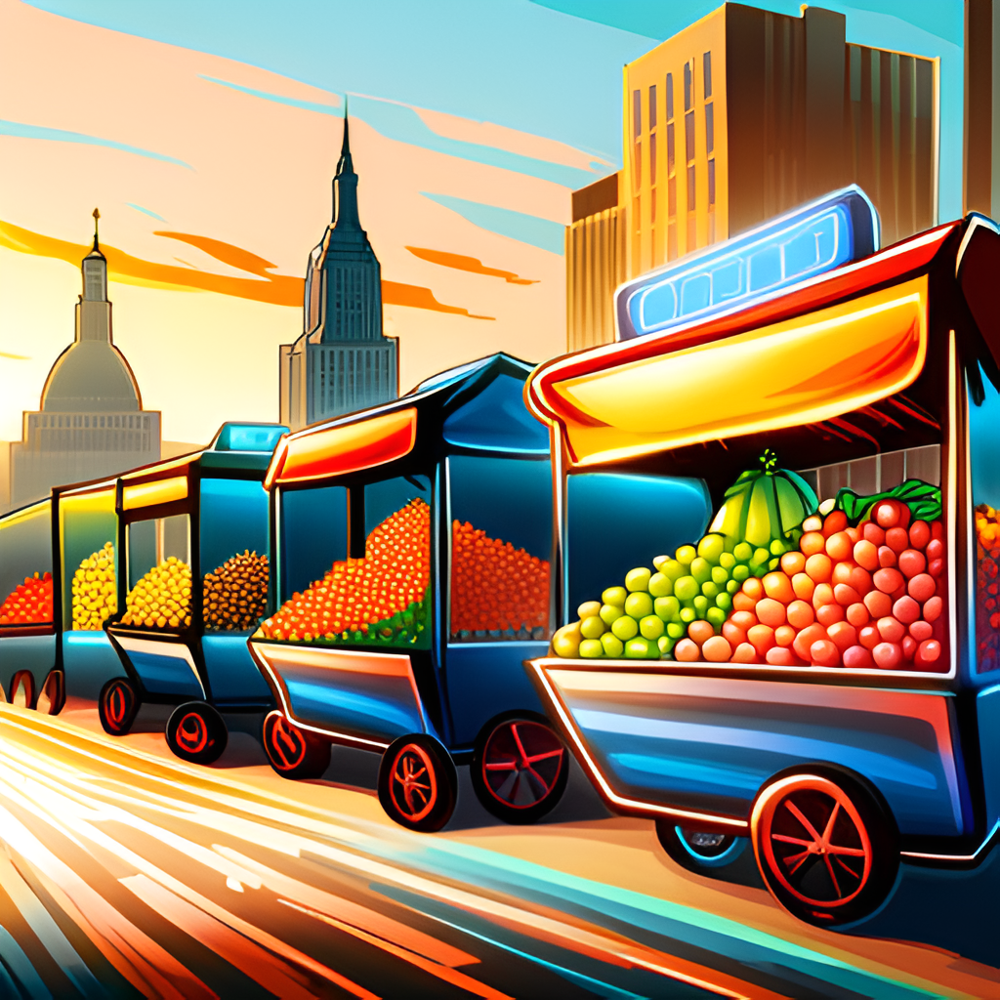

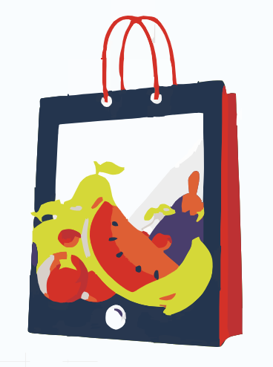

IntelliCART
(Intelligent RehriWala)
“Transforming Roadside Fruit and Vegetables Vendors with AI-Powered Classification and Customer Vendor Convenience”
Department of Computer Science, FAST-NUCES, Karachi, Pakistan
FYP-II Progress

Slide 2

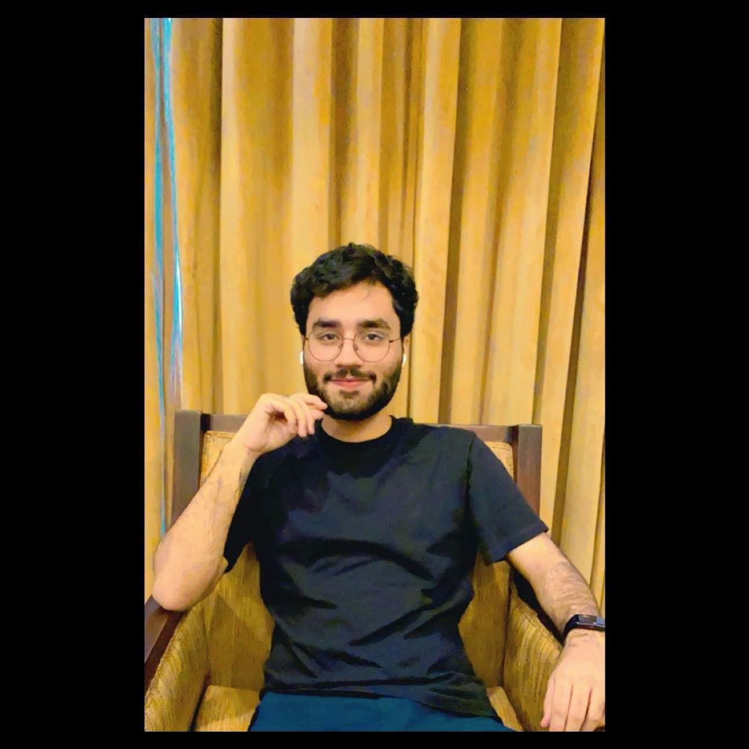
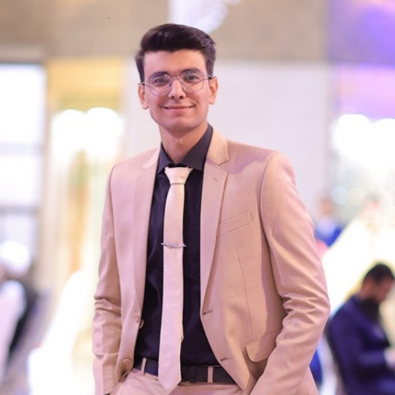
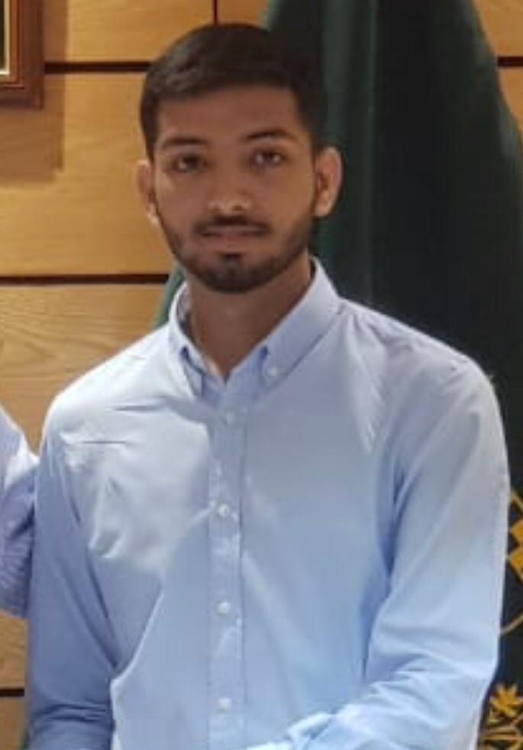
Project Team
Project Supervisor
Dr. Muhammad Farrukh Shahid
Project Members
Abdul Ahad Shaikh
20K-0477
Mohammad Basil Ali Khan
20K-0477
Syed Jodat Ali Naqvi
20K-0155

Slide 3
Introduction
Welcome To The Future Of Urban Fruit’s And Vegs Supply Chain Solution.
This Project Aims To Revolutionize The Vegetables And Fruits Retail Market, Especially The Roadside Vendors. Harnessing The Power Of AI, This Project Will Enable Customers To Identify Fresh Fruits And Vegs Just From Their Cell Phones And Locate Their Required Fruit.
Upgrading These Rehris Would Provide Convenience To Both Customers And Sellers Through Smooth Retail, Also Reducing Traffic Congestions.

Slide 4
Problem Statement
Fruit vending market is quite unmanaged, neither the prices are controlled by government nor the quality, thus customers face difficulty in finding and classifying healthy fruits, leading to compromised choices. This sector even lacks the proper infrastructure to facilitate customers. Considering these we are stepping up to solve these issues leveraging the power of AI.

Slide 5
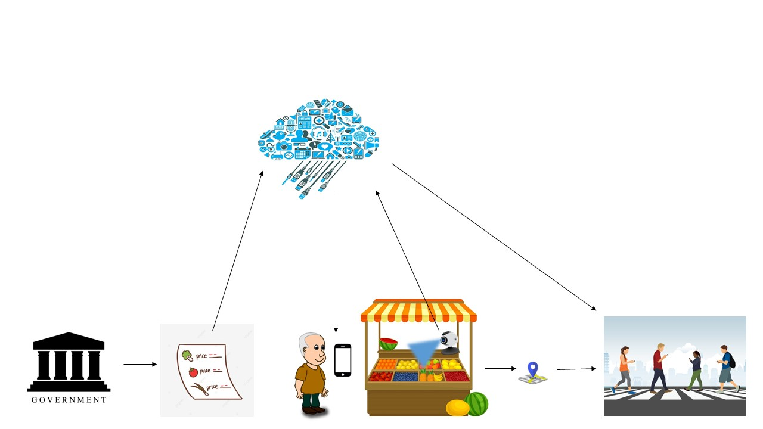
Proposed Scenario
Cloud Storage
IntelliCart
Government department that releases daily fruits and vegetable price list.
Customers
Global Position Service
Fruits / Vegetables Price List
Seller

Slide 6
FYP-II Deliverables
Show details of every dataset
Clearly show performance of each models on each dataset
Application Design
Integration of MobileNet in Application
Implementation of YOLO for improved real-time object detection

Slide 7
Show details of every dataset
We used Dataset from a total of 6 sources:
IEEE_DataPort – FruitGB.
Kaggle – Fruits and Vegetables.
Mendeley – FruitNet.
Mendeley- VegNet.
Dataset Camera (Our Own Dataset).
Mendeley – Fresh and Rotten Fruits.
(Links are provided towards the end of slides)
7

Slide 8
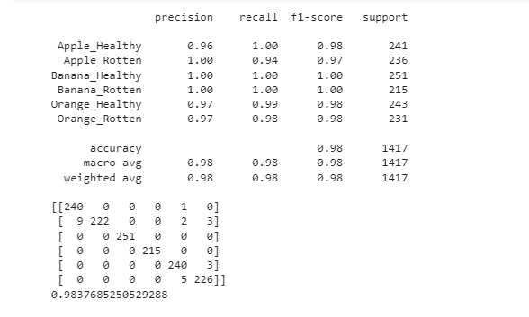
IEEE_DataPort - FruitGB
This Dataset contained the following classes:
Healthy Apples
Rotten Apples
Healthy Bananas
Rotten Bananas
Healthy Oranges
Rotten Oranges

Slide 9
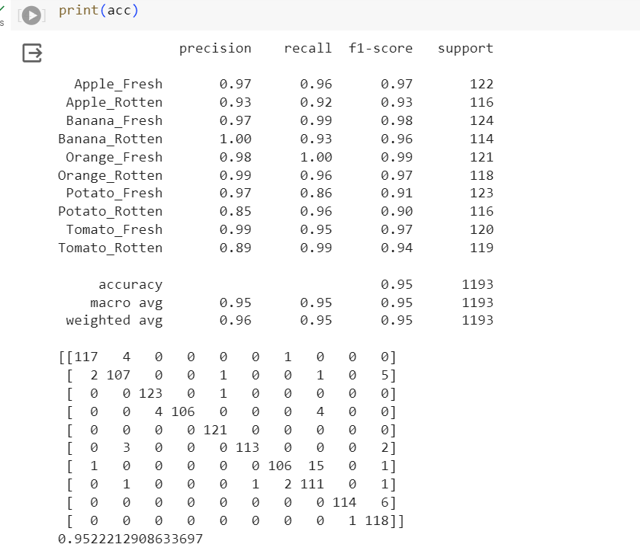
Kaggle – Fruits and Vegetables Dataset
This Dataset contained the following classes:
Fresh Apple
Rotten Apple
Fresh Bananas
Rotten Bananas
Fresh Oranges
Rotten Oranges
Fresh Potatoes
Rotten Potatoes
Fresh Tomatoes
Rotten Tomatoes

Slide 10
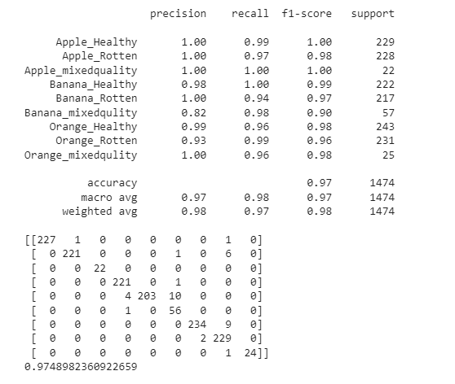
Mendeley- FruitNet
This Dataset contained the following classes:
Healthy Apple
Apple Mixed
Rotten Apple
Healthy Bananas
Banana Mixed
Rotten Bananas
Healthy Oranges
Oranges Mixed
Rotten Oranges

Slide 11
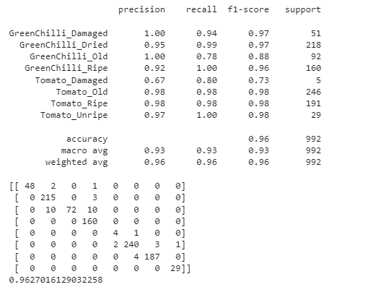
Mendeley- VegNet
This Dataset contained the following classes:
Damaged GreenChilli
Dried GreenChilli
Old Greenchilli
Ripe GreenChilli
Damaged Tomatoes
Old Tomatoes
Ripe Tomatoes
Unripe Tomatoes

Slide 12
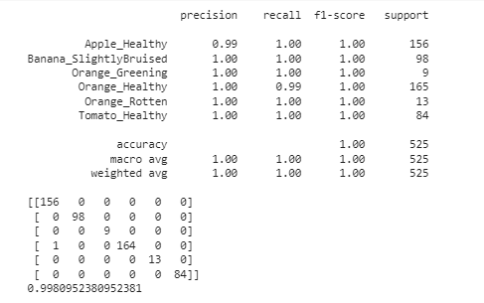
Dataset Camera (Our Own Dataset)
This Dataset contained the following classes:
Healthy Apple
Slightly Bruised Bananas
Green Oranges
Healthy Oranges
Rotten Oranges
Healthy Tomatoes

Slide 13
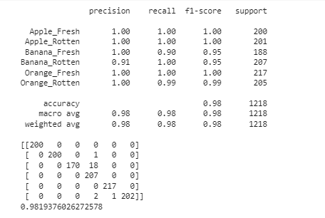
Mendeley – Fresh and Rotten Fruits
This Dataset contained the following classes:
Fresh Apples
Rotten Apples
Fresh Bananas
Rotten Bananas
Fresh Oranges
Rotten Oranges

Slide 14
Clearly show performance of each models on each dataset
 | Data Source | Data Size (no. Of images) |  | No. Of classes | MobileNet Results (Accuracy) | Inception-V3 Results (Accuracy) | VGG19 Results (Accuracy) | AlexNet Results (Accuracy) | Reference
 |  | Train | Test
1 | IEEE_DataPort - FruitGB | 5890 | 1417 | 6 | 98.3% | 99.0% | 99.01% | 87.58% | 1
2 | Kaggle - Fruits and Vegetables dataset | 4804 | 1196 | 10 | 95.22% | 92.79% | 89.85% | 81.14% | 2
3 | Mendeley - FruitNet | 5914 | 1474 | 9 | 97.49% | 97.35% | 96.94% | 92.33% | 3
4 | Mendeley - VegNet | 3982 | 992 | 8 | 96.27% | 94.15% | 91.73% | 77.01% | 4
5 | Dataset Camera | 2108 | 525 | 6 | 99.81% | 97.90% | 99.42% | 99.04% | 5
6 | Mendeley - Fresh and Rotten Fruits | 4594 | 1146 | 6 | 98.19% | 99.26% | 97.86% | 61.24% | 6

Slide 15
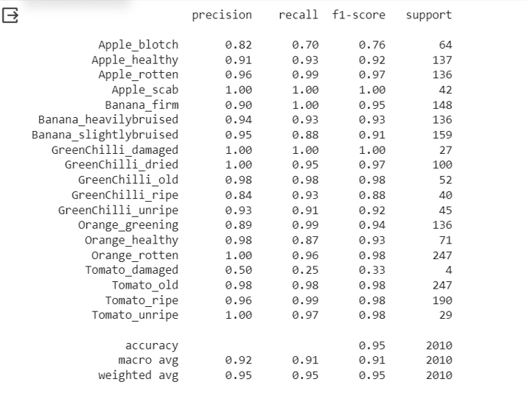
MobileNet
MobileNet is a convolutional neural network that uses depthwise separable convolutions and has an input size of 224 by 224.
Mobile Net split the convolution into a 3x3 depth-wise convolution and a 1x1 pointwise convolution, as shown in the figure.
We implemented MobileNet on our dataset and achieved an accuracy of 95%.
TPR average | 0.9058942945130736
FPR average | 0.002858193302300445
TNR average | 0.9971418066976995
FNR average | 0.0941057054869264

Slide 16
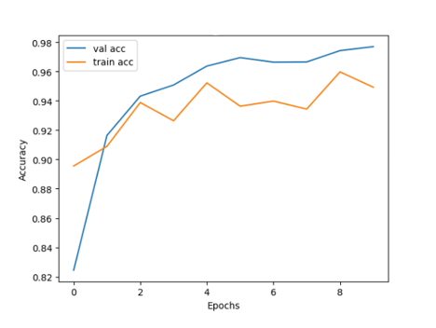
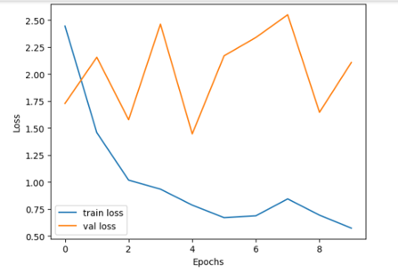
MobileNet Accuracy and Loss

Slide 17
Why we chose MobileNet? (Best Accuracy)
Many real-life classification applications, such as robotics, autonomous driving, smartphone, etc, the
classification task is highly constrained by the computational resources that are available.
The problem thus becomes to pursue the optimal accuracy subject to a limited computational budget (i.e.
memory and/or MFLOPs).
MobileNet is a type of convolutional neural network (CNN) that has been specifically designed for use on mobile devices with limited computational resources. It has the following advantages:
1. Lightweight architecture: MobileNet has a smaller number of parameters compared to other deep learning models, which makes it ideal for deployment on mobile devices and other embedded systems with limited resources.
2. Speed: Because MobileNet has fewer parameters, it is faster to train and run than other deep learning models. This makes it an ideal choice for real-time applications such as object detection and image recognition.
3. Accuracy: Despite its lightweight architecture, MobileNet can achieve high accuracy on a variety of tasks, including image classification and object detection. It has been shown to perform well on benchmark datasets such as ImageNet.
4. Compatibility: MobileNet is compatible with a wide range of deep learning frameworks, including TensorFlow, Keras, and PyTorch. This makes it easy to integrate MobileNet into existing deep learning workflows and frameworks.

Slide 18
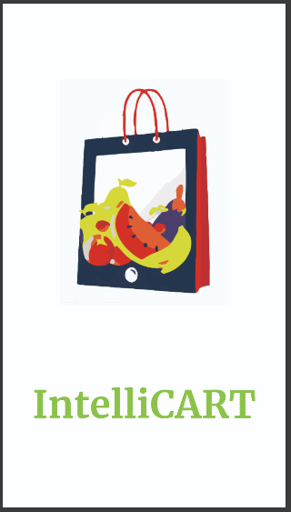
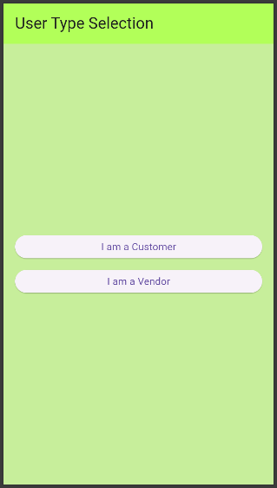
Application Design

Slide 19
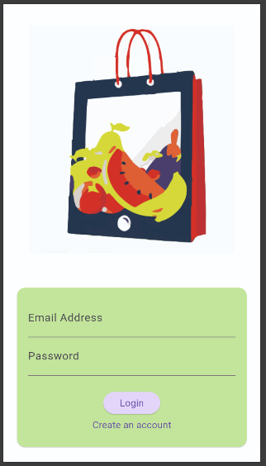
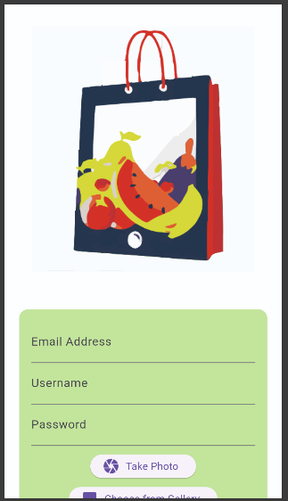
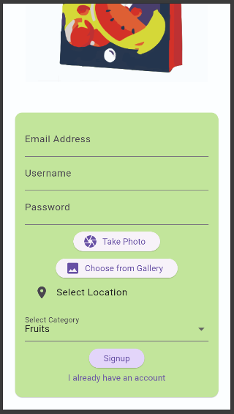
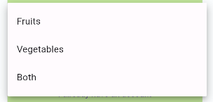
Vendor Side
Vendor Login
Vendor Registration

Slide 20
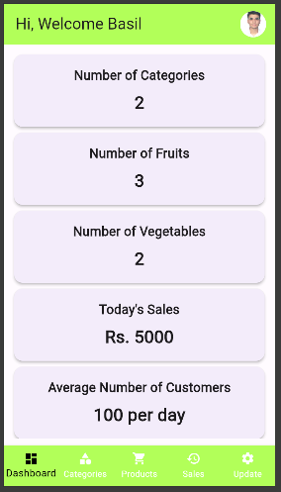
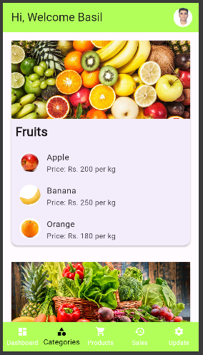
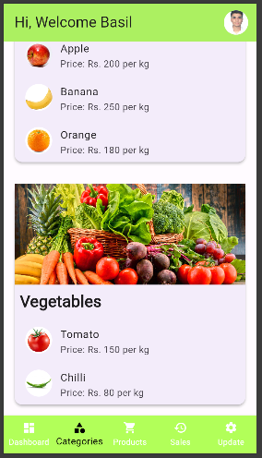
Vendor Side (Contd.)
Dashboard
Categories

Slide 21
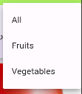
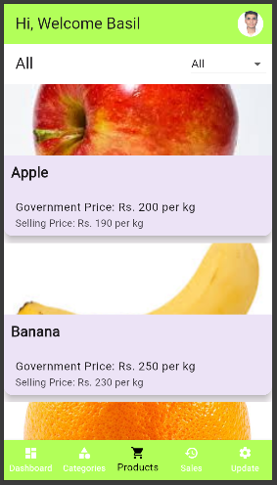
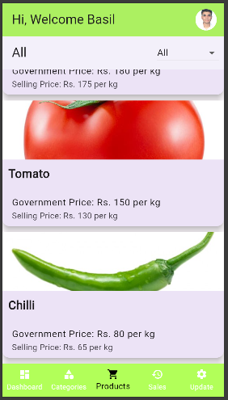
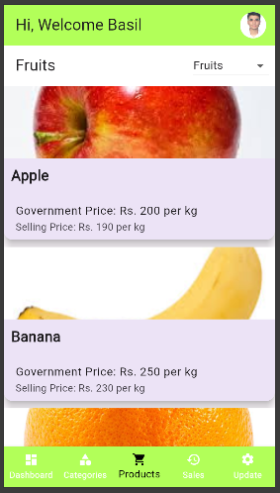
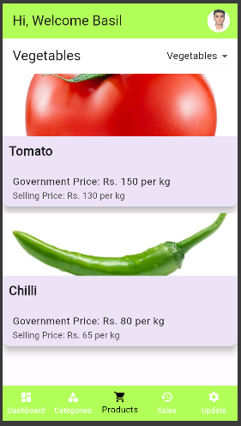
Vendor Side (Contd.)
Fruits
Vegetables
Products

Slide 22
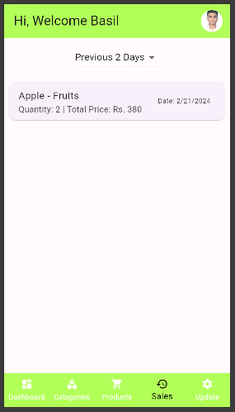
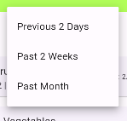
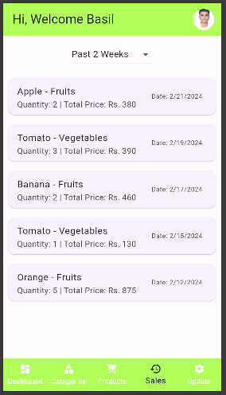
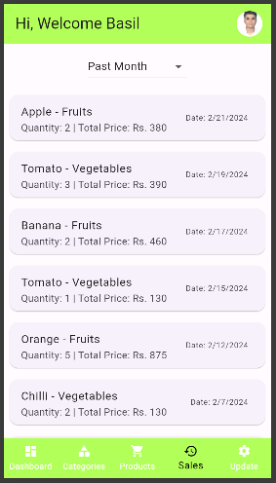
Vendor Side (Contd.)
2 Weeks
Month
Products

Slide 23
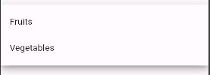
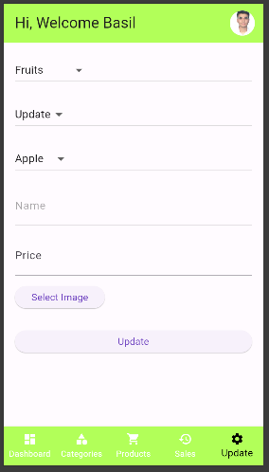
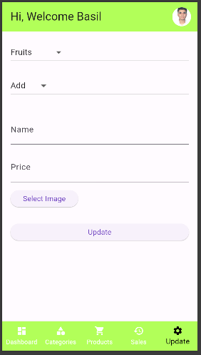
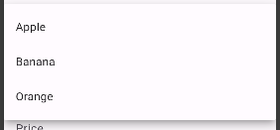
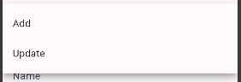
Vendor Side (Contd.)
Update
Add New Fruits or Update Existing ones

Slide 24
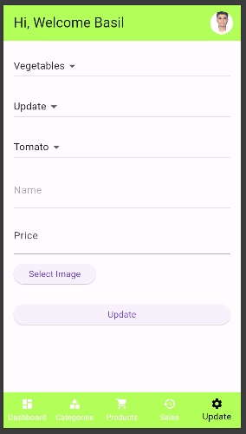
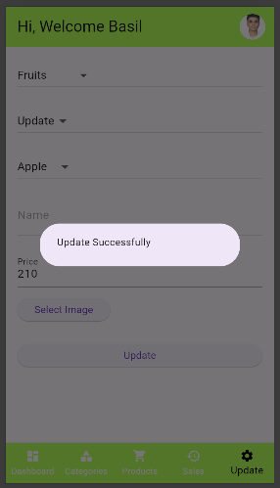
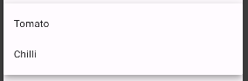
Vendor Side (Contd.)
Add New Vegetables or Update Existing ones
Successful addition / updating

Slide 25
Vendor Side (Contd.)
Update
Add New Fruits or Update Existing ones

Slide 26
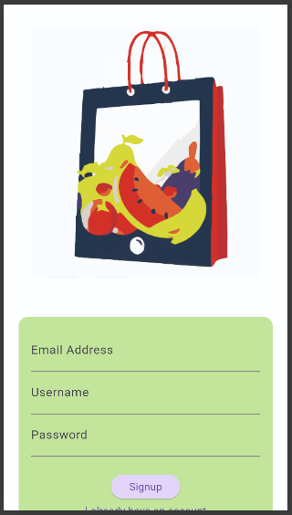
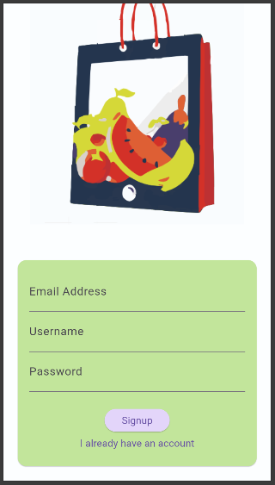
Customer Side
Customer Login
Customer Registration

Slide 27
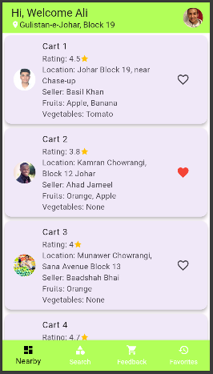
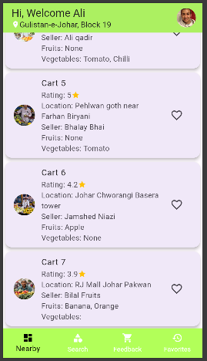
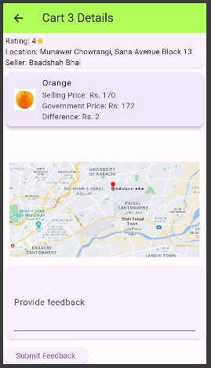
Customer Side (Contd.)
Nearby Vendors
Vendors Details

Slide 28
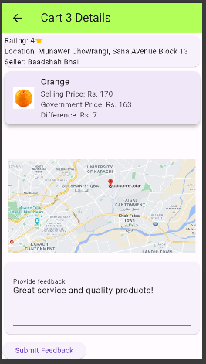
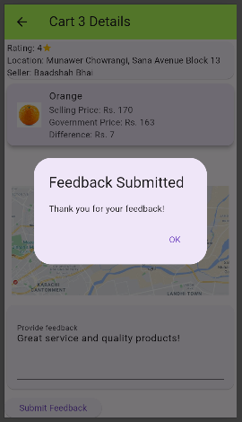
Customer Side (Contd.)
Feedback Submission

Slide 29
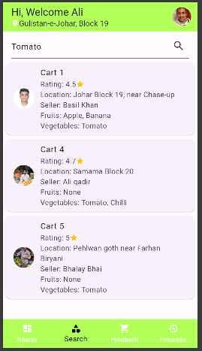
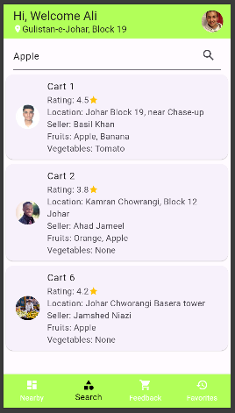



Customer Side (Contd.)
Searching for vegetables
Searching for fruits
Searching for desired products

Slide 30


Customer Side (Contd.)
Feedback History
Favorites

Slide 31



Integration of MobileNet
Quality assessment by taking picture

Slide 32



Integration of MobileNet (Contd.)
Quality assessment by uploading picture

Slide 33






Integration of MobileNet (Contd.) Demo Results and Videos

Slide 34



Integration of MobileNet (Contd.) Demo Results and Videos

Slide 35
References
1- Top Indian Fruits: IEEE-dataport.org - fruitsgb-top-indian-fruits-quality
2- Fruits and Vegetables Dataset: Kaggle - Fruits and Vegetables dataset
3- Mixed Quality Fruits: FruitNet: Indian Fruits Dataset with quality (Good, Bad & Mixed quality)
4- Vegetable Dataset: VegNet: Vegetable Dataset with quality (Unripe, Ripe, Old, Dried and Damaged)
5-Our own Dataset: Our Dataset
6- Fresh and Rotten Fruits: Fresh and Rotten Fruits Dataset for Machine-Based Evaluation of Fruit Quality

Slide 36


Implementation of YOLO for improved real-time object detection (Contd.) Demo Videos

Slide 37


Implementation of YOLO for improved real-time object detection (Contd.) Demo Videos

Slide 38


Implementation of YOLO for improved real-time object detection (Contd.) Demo Videos

Slide 39


